Slide 1
Optimal solutions
and where to find them
Source https://www.researchgate.net/publication/323869087_A_new_formulation_and_solution_for_the_nurse_scheduling_problem_A_case_study_in_Egypt

Slide 2

 | Mon | Tue | Wed | Thu | Fri | Sat | Sun
Guri Malla | X |  |  |  |  |  | X
Søren Klype | X |  | X |  | X | X
Helle Dussen |  |  |  | X
Fader Ullan | X |  | X
Milde Moses |  | X |  |  | X | X
Gamle-Eirik |  | X |  | X |  | X | X
Noa Gubban |  | X |  |  | X
Vittig-Per |  |  | X |  |  |  | X
Finn Urlig | X |  |  | X
 | Mon | Tue | Wed | Thu | Fri | Sat | Sun
Guri Malla |  | X |  |  |  |  | X
Søren Klype | X |  |  | X | X | X
Helle Dussen |  |  | X |  |  | X
Fader Ullan | X |  |  | X |  |  | X
Milde Moses | X |  |  |  | X | X
Gamle-Eirik |  | X | X
Noa Gubban |  | X |  |  | X
Vittig-Per | X |  | X | X
Finn Urlig |  |  |  |  |  |  | X

Slide 3
 | Man | Tue | Wed | Thu | Fri | Sat | Sun
Guri Malla | X |  |  |  |  |  | X
Søren Klype | X |  | X |  | X | X
Helle Dussen |  |  |  | X
Fader Ullan | X |  | X
Milde Moses |  | X |  |  | X | X
Gamle-Eirik |  | X |  | X |  | X | X
Noa Gubban |  | X |  |  | X
Vittig-Per |  |  | X |  |  |  | X
Finn Urlig | X |  |  | X
 | Man | Tue | Wed | Thu | Fri | Sat | Sun
Min. workers | 4 | 4 | 3 | 4 | 5 | 5 | 3
Ant. team leads | 1 | 1 | 1 | 1 | 2 | 2 | 1
 | Guri Malla | Søren Klype | Helle Dussen | Fader Ullan | Milde Moses | Gamle-Eirik | Noa Gubben | Vittig-Per | Finn Urlig
Team Leader | X | X | X | X
Min. shifts | 2 | 3 | 3 | 3 | 2 | 2 | 1 | 1 | 1
Max. shifts | 2 | 5 | 5 | 5 | 5 | 5 | 4 | 4 | 2
$ per shift | 2500,- | 2300,- | 2300,- | 1800,- | 1500,- | 1500,- | 1500,- | 1000,- | 800,-

Slide 4
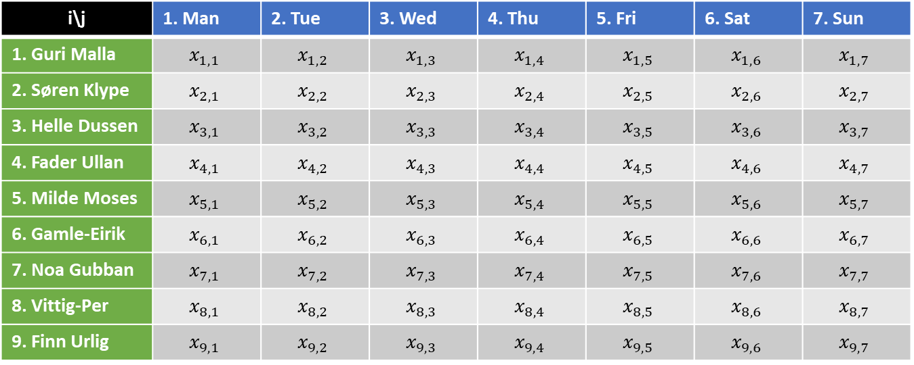
i\j | 1. Man | 2. Tue | 3. Wed | 4. Thu | 5. Fri | 6. Sat | 7. Sun
1. Guri Malla | $$x_{1,1}$$ | $$x_{1,2}$$ | $$x_{1,3}$$ | $$x_{1,4}$$ | $$x_{1,5}$$ | $$x_{1,6}$$ | $$x_{1,7}$$
2. Søren Klype | $$x_{2,1}$$ | $$x_{2,2}$$ | $$x_{2,3}$$ | $$x_{2,4}$$ | $$x_{2,5}$$ | $$x_{2,6}$$ | $$x_{2,7}$$
3. Helle Dussen | $$x_{3,1}$$ | $$x_{3,2}$$ | $$x_{3,3}$$ | $$x_{3,4}$$ | $$x_{3,5}$$ | $$x_{3,6}$$ | $$x_{3,7}$$
4. Fader Ullan | $$x_{4,1}$$ | $$x_{4,2}$$ | $$x_{4,3}$$ | $$x_{4,4}$$ | $$x_{4,5}$$ | $$x_{4,6}$$ | $$x_{4,7}$$
5. Milde Moses | $$x_{5,1}$$ | $$x_{5,2}$$ | $$x_{5,3}$$ | $$x_{5,4}$$ | $$x_{5,5}$$ | $$x_{5,6}$$ | $$x_{5,7}$$
6. Gamle-Eirik | $$x_{6,1}$$ | $$x_{6,2}$$ | $$x_{6,3}$$ | $$x_{6,4}$$ | $$x_{6,5}$$ | $$x_{6,6}$$ | $$x_{6,7}$$
7. Noa Gubban | $$x_{7,1}$$ | $$x_{7,2}$$ | $$x_{7,3}$$ | $$x_{7,4}$$ | $$x_{7,5}$$ | $$x_{7,6}$$ | $$x_{7,7}$$
8. Vittig-Per | $$x_{8,1}$$ | $$x_{8,2}$$ | $$x_{8,3}$$ | $$x_{8,4}$$ | $$x_{8,5}$$ | $$x_{8,6}$$ | $$x_{8,7}$$
9. Finn Urlig | $$x_{9,1}$$ | $$x_{9,2}$$ | $$x_{9,3}$$ | $$x_{9,4}$$ | $$x_{9,5}$$ | $$x_{9,6}$$ | $$x_{9,7}$$
Shifts
1
2
3
4
5
6
7
Workers
1
2
3
4
5
6
7
8
9

Slide 5
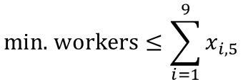
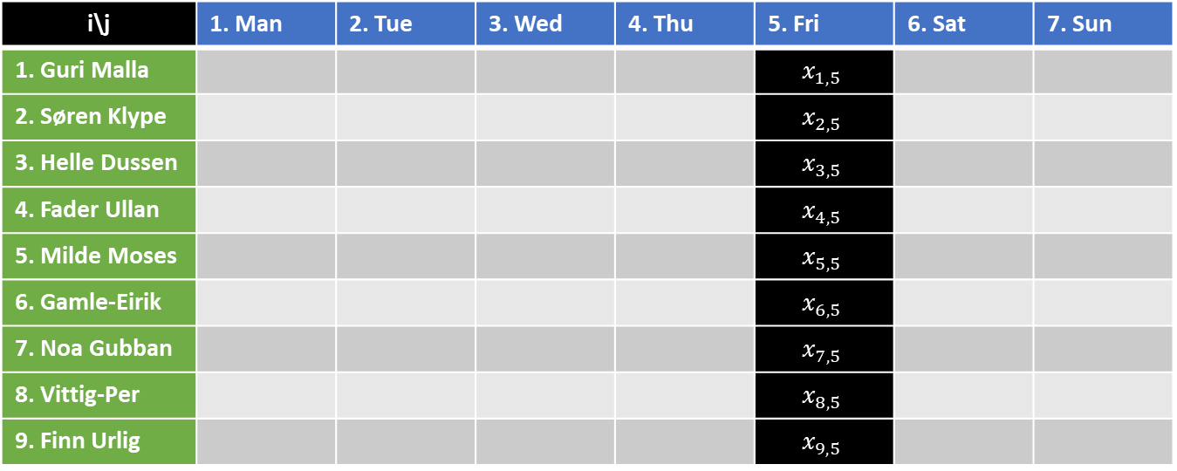
i\j | 1. Man | 2. Tue | 3. Wed | 4. Thu | 5. Fri | 6. Sat | 7. Sun
1. Guri Malla |  |  |  |  | $$x_{1,5}$$
2. Søren Klype |  |  |  |  | $$x_{2,5}$$
3. Helle Dussen |  |  |  |  | $$x_{3,5}$$
4. Fader Ullan |  |  |  |  | $$x_{4,5}$$
5. Milde Moses |  |  |  |  | $$x_{5,5}$$
6. Gamle-Eirik |  |  |  |  | $$x_{6,5}$$
7. Noa Gubban |  |  |  |  | $$x_{7,5}$$
8. Vittig-Per |  |  |  |  | $$x_{8,5}$$
9. Finn Urlig |  |  |  |  | $$x_{9,5}$$
Shifts
1
2
3
4
5
6
7
$$\text{min}\text{. }\text{workers}≤\sum_{i=1}^{9}{x_{i,5}}$$
Workers
1
2
3
4
5
6
7
8
9

Slide 6
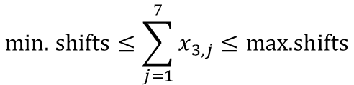
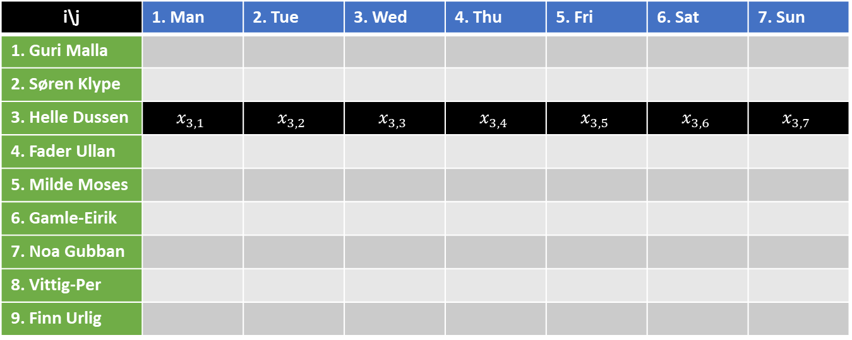
i\j | 1. Man | 2. Tue | 3. Wed | 4. Thu | 5. Fri | 6. Sat | 7. Sun
1. Guri Malla
2. Søren Klype
3. Helle Dussen | $$x_{3,1}$$ | $$x_{3,2}$$ | $$x_{3,3}$$ | $$x_{3,4}$$ | $$x_{3,5}$$ | $$x_{3,6}$$ | $$x_{3,7}$$
4. Fader Ullan
5. Milde Moses
6. Gamle-Eirik
7. Noa Gubban
8. Vittig-Per
9. Finn Urlig
Shifts
1
2
3
4
5
6
7
$$\text{min}\text{. }\text{shifts}≤\sum_{j=1}^{7}{x_{3,j}}≤\text{max}\text{.}\text{shifts}$$
Workers
1
2
3
4
5
6
7
8
9

Slide 7
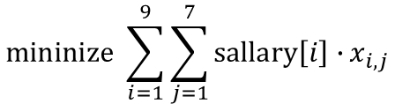
i\j | 1. Man | 2. Tue | 3. Wed | 4. Thu | 5. Fri | 6. Sat | 7. Sun
1. Guri Malla | $$x_{1,1}$$ | $$x_{1,2}$$ | $$x_{1,3}$$ | $$x_{1,4}$$ | $$x_{1,5}$$ | $$x_{1,6}$$ | $$x_{1,7}$$
2. Søren Klype | $$x_{2,1}$$ | $$x_{2,2}$$ | $$x_{2,3}$$ | $$x_{2,4}$$ | $$x_{2,5}$$ | $$x_{2,6}$$ | $$x_{2,7}$$
3. Helle Dussen | $$x_{3,1}$$ | $$x_{3,2}$$ | $$x_{3,3}$$ | $$x_{3,4}$$ | $$x_{3,5}$$ | $$x_{3,6}$$ | $$x_{3,7}$$
4. Fader Ullan | $$x_{4,1}$$ | $$x_{4,2}$$ | $$x_{4,3}$$ | $$x_{4,4}$$ | $$x_{4,5}$$ | $$x_{4,6}$$ | $$x_{4,7}$$
5. Milde Moses | $$x_{5,1}$$ | $$x_{5,2}$$ | $$x_{5,3}$$ | $$x_{5,4}$$ | $$x_{5,5}$$ | $$x_{5,6}$$ | $$x_{5,7}$$
6. Gamle-Eirik | $$x_{6,1}$$ | $$x_{6,2}$$ | $$x_{6,3}$$ | $$x_{6,4}$$ | $$x_{6,5}$$ | $$x_{6,6}$$ | $$x_{6,7}$$
7. Noa Gubban | $$x_{7,1}$$ | $$x_{7,2}$$ | $$x_{7,3}$$ | $$x_{7,4}$$ | $$x_{7,5}$$ | $$x_{7,6}$$ | $$x_{7,7}$$
8. Vittig-Per | $$x_{8,1}$$ | $$x_{8,2}$$ | $$x_{8,3}$$ | $$x_{8,4}$$ | $$x_{8,5}$$ | $$x_{8,6}$$ | $$x_{8,7}$$
9. Finn Urlig | $$x_{9,1}$$ | $$x_{9,2}$$ | $$x_{9,3}$$ | $$x_{9,4}$$ | $$x_{9,5}$$ | $$x_{9,6}$$ | $$x_{9,7}$$
Shifts
1
2
3
4
5
6
7
$$\text{mininize} \sum_{i=1}^{9}{\sum_{j=1}^{7}{\text{sallary}\left[i\right]∙}}x_{i,j}$$
Workers
1
2
3
4
5
6
7
8
9

Slide 8
 | Project A | Project B | Project C | Project D
Guri Malla | X
Søren Klype |  | X
Helle Dussen |  | X
Fader Ullan |  |  | X
Milde Moses |  |  |  | X
Fabian Fy |  |  | X
Noa Gubban | X
Vittig-Per |  |  |  | X
Finn Urlig |  |  |  | X

